Slide 1
Intro to Arduino: Build a Digital Music Box

Slide 2
The goal of this class
Answer #1: Build a digital music box
The real answer:
To leave this class with an Arduino platform (the music box) and the skills needed to play around with it
BT

Slide 3
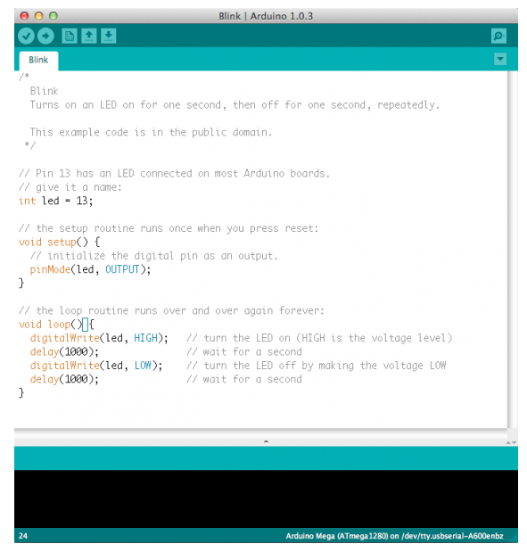
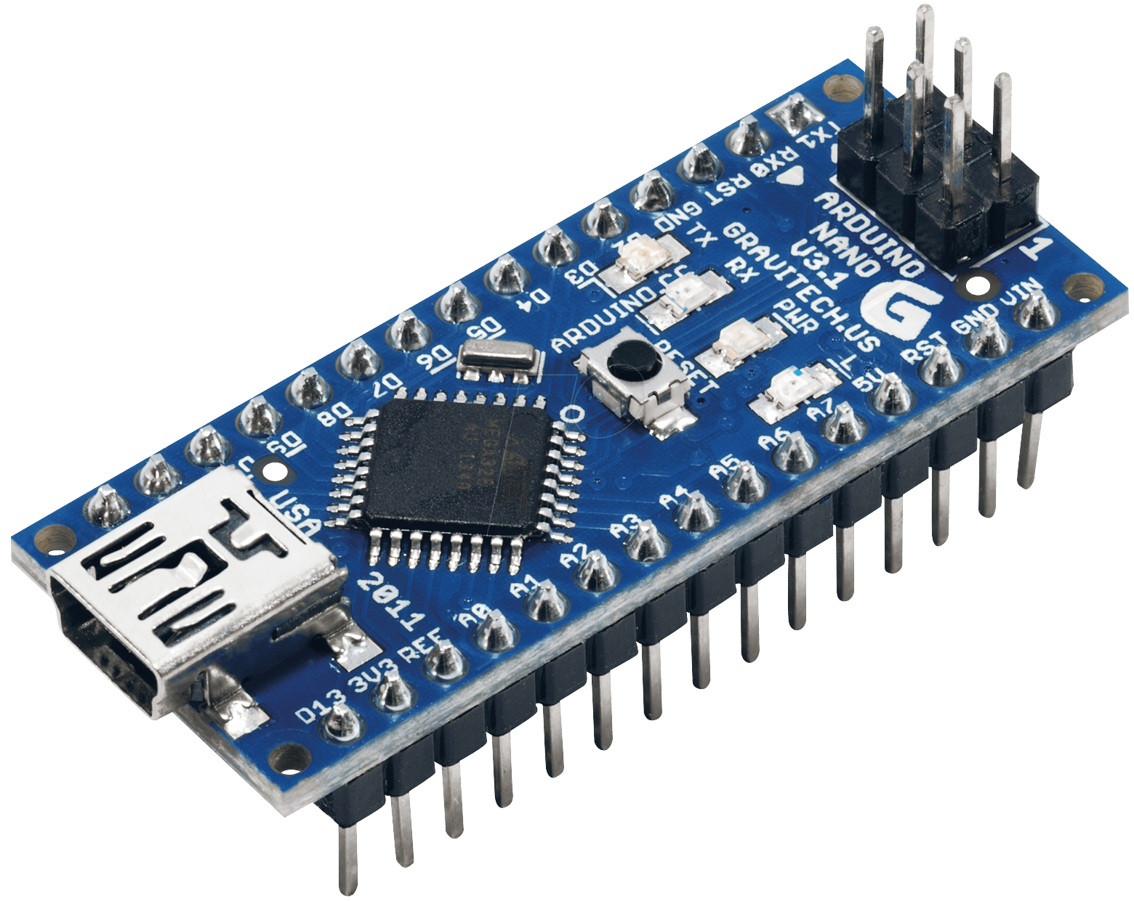
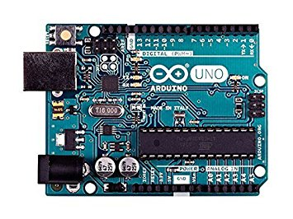
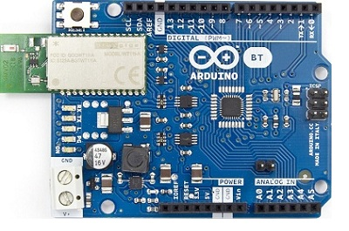
What is an Arduino?
“Arduino is an open-source electronics platform based on easy-to-use hardware and software” (arduino.cc)
Arduino IDE (Integrated Development Environment)
Arduino boards
“Integrated”: contains all of the various software components needed to write code, compile it and upload it to an Arduino board
BT

Slide 4
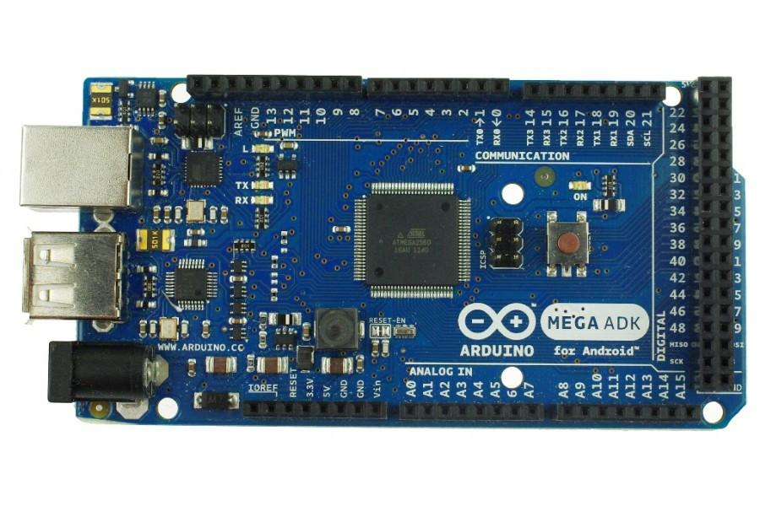
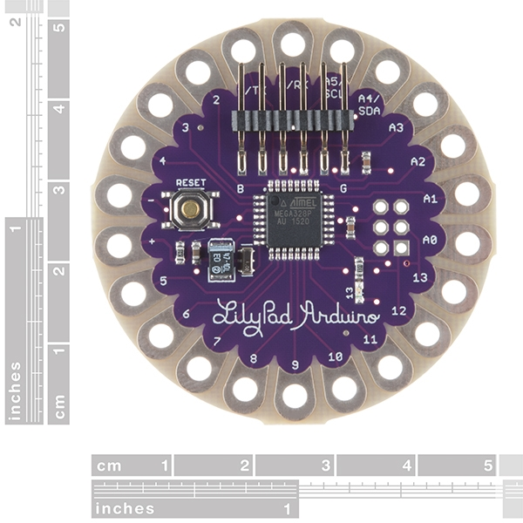
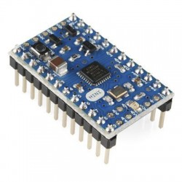
There is a wide variety of Arduino Boards
Uno
Mega
Lilypad
BT
BT
Nano
Pro Mini

Slide 5
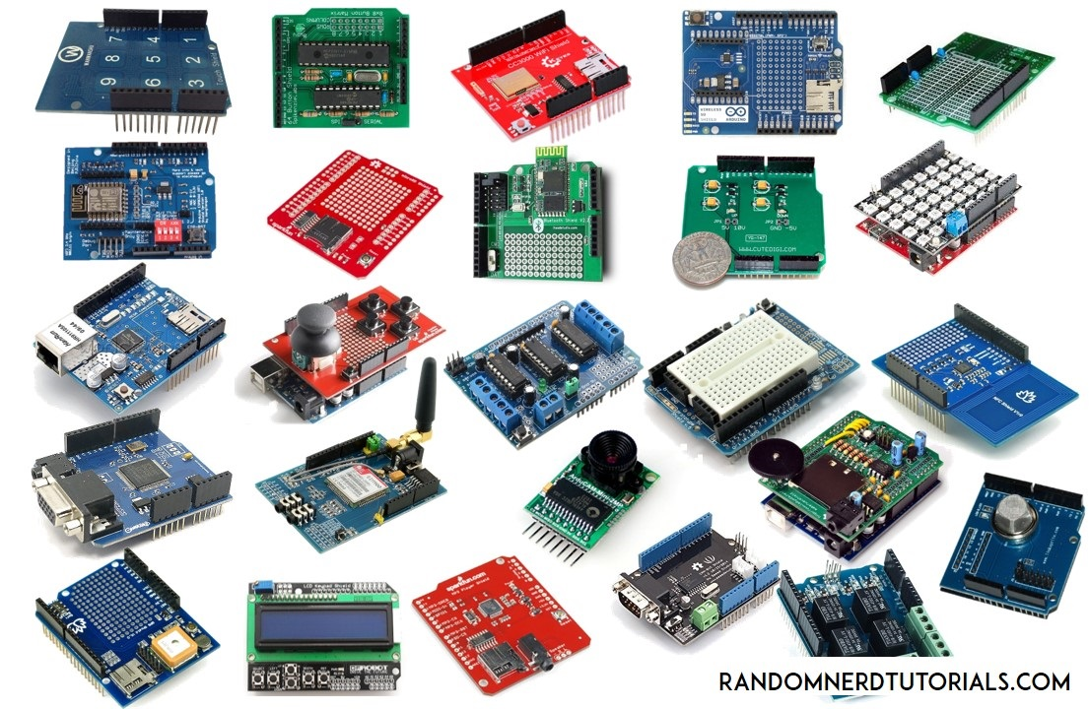
There is also a wide variety of accessories such as “shields”
BT

Slide 6
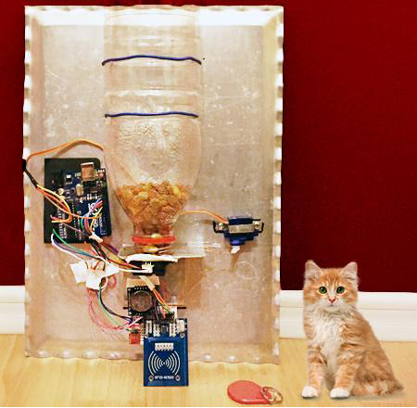
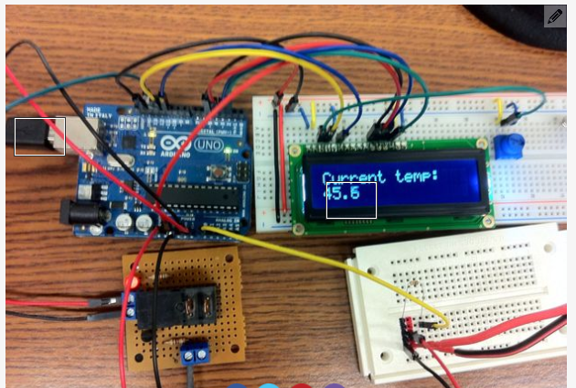
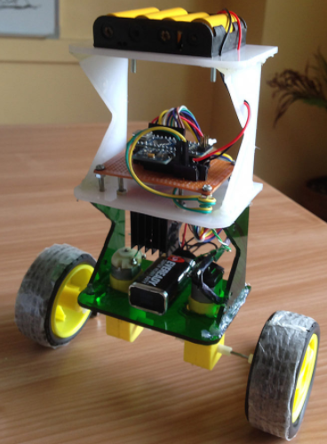
What does an Arduino do?
An Arduino is a general purpose tool that simply executes whatever instructions you give it
Pet Feeder
Sous Vide Cooker
At 8am and 5pm send a signal to the motor so it rotates and dispenses food
Self-Balancing Robot
If the temperature is too low, turn the heater on
If the temperature is too high, turn the heater off
BT
If leaning forward spin motors forward
If leaning backwards, spin motors backwards

Slide 7
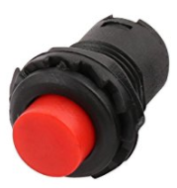
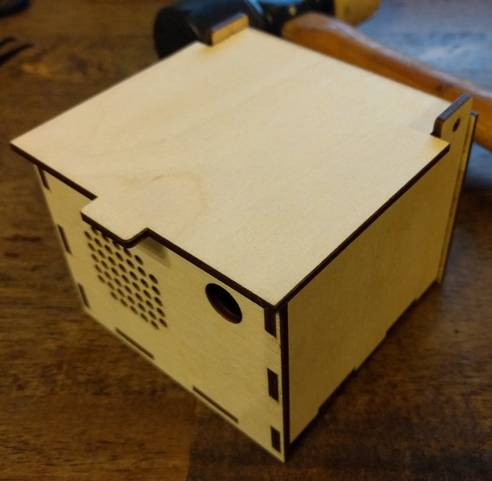
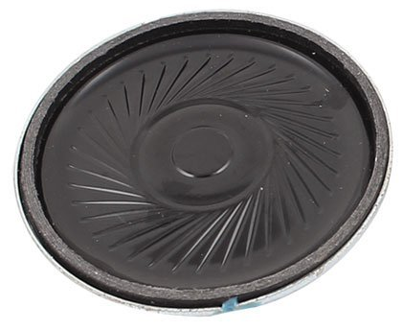
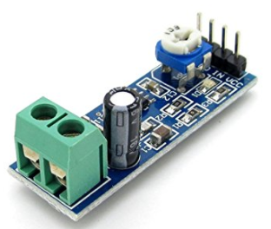
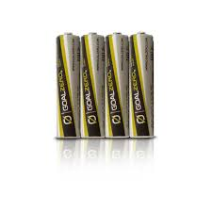
What are we building today?
Switch
(To Control It)
Arduino Nano
(The Brain)
Audio Amplifier
(Increases volume)
Speaker
(So you can hear it)
Batteries
(Power Source)

Slide 8
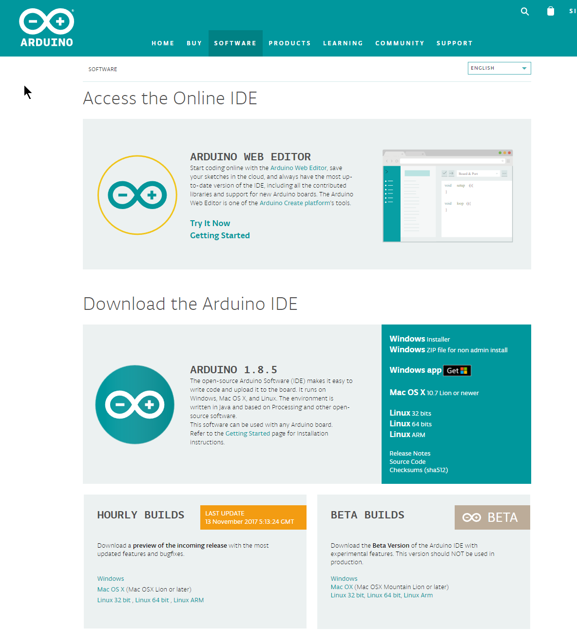
Best way to learn is hands-on so let’s get started
Download and install the Arduino IDE
- (and build the laser cut box)
Do a web search for “Arduino ide” and click on the appropriate link or just type it in:
https://www.arduino.cc/en/Main/Software
Download and install according to your platform

Slide 9
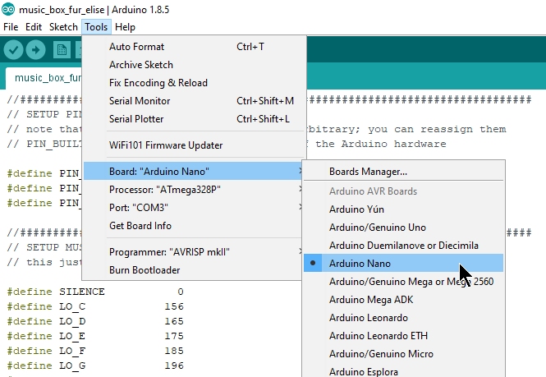
Configure the IDE – Select the correct board
Set the board type:
Tools->Board->Arduino Nano
This refers to the Arduino board that is being used
When using a new board, check the documentation

Slide 10
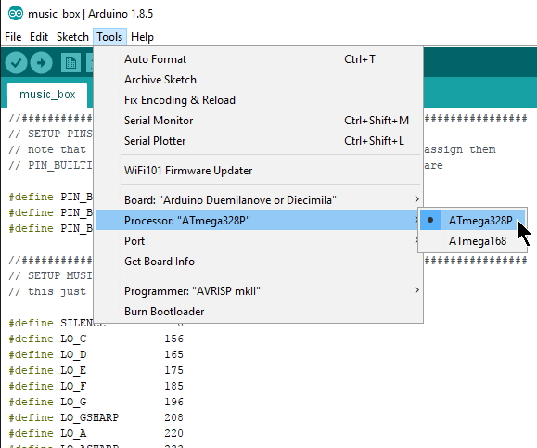
Configure the IDE – Select the correct processor
Set the processor type:
Tools->Processor->ATmega328P
This refers to the “CPU” or “microprocessor” (that is the primary hardware component) on the Arduino board.
Most boards seem to use the ATmega 328
When using a new board, check the documentation

Slide 11
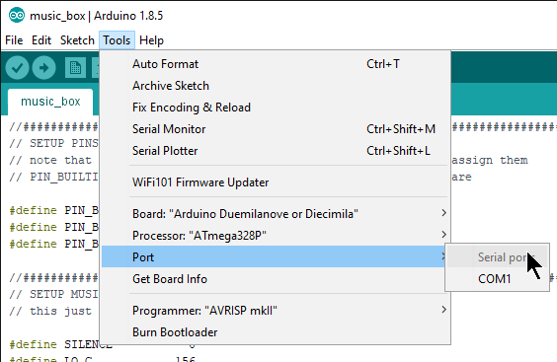
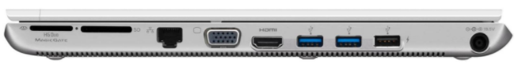
Configure the IDE – Select the correct port
Set the port:
Tools->Port->[this depends on your system]
This is the (typically USB) port on your computer that will be used to send data from the computer to the Arduino
You often have to figure out which one is correct through trial and error

Slide 12
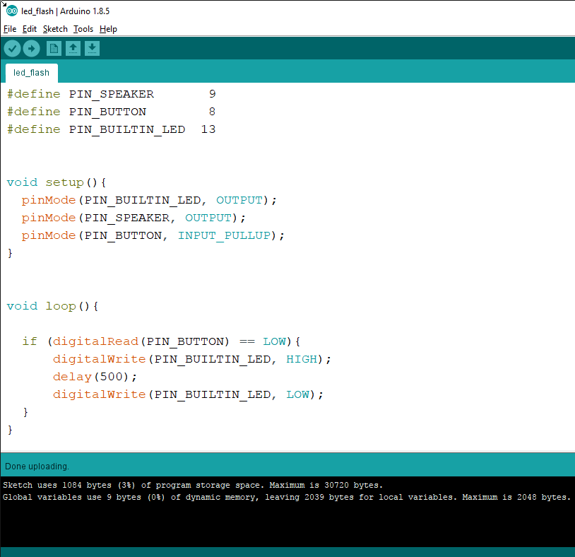
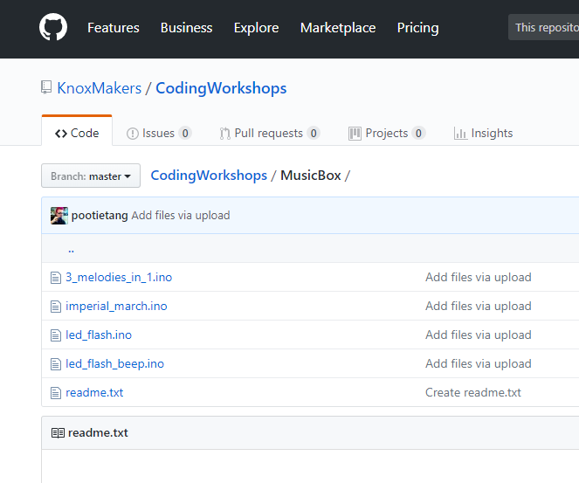
Download the led_flash sketch and upload to your Arduino
Download “led_flash.ino” from KM github
https://github.com/KnoxMakers/CodingWorkshops/tree/master/MusicBox
Upload to Arduino using the upload button:
Look for the “Done uploading” (or errors) in the status bar

Slide 13
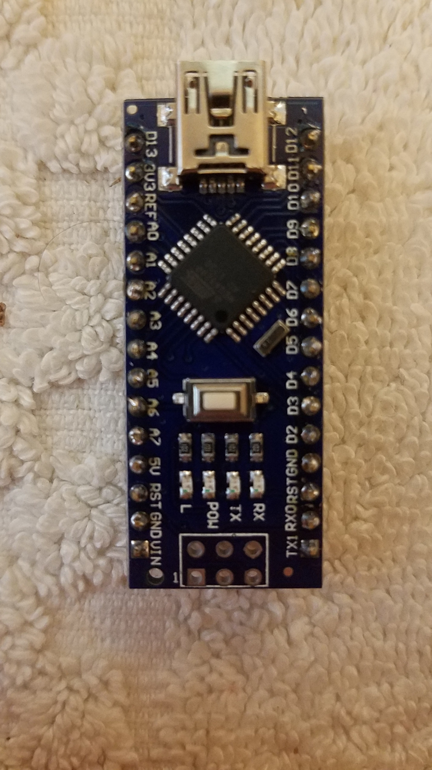
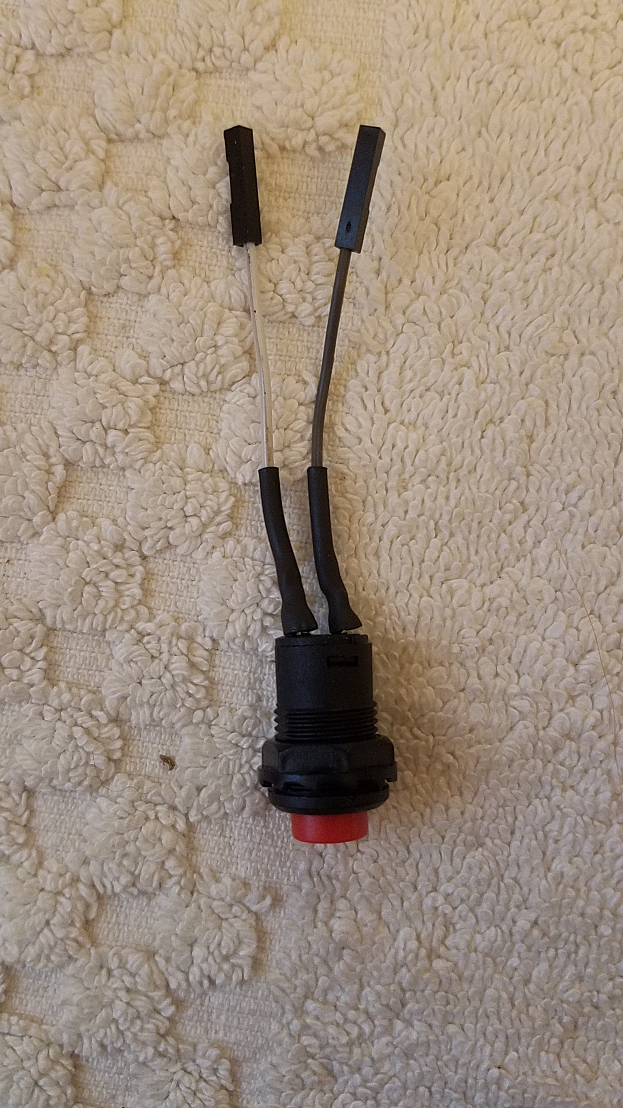
Connect the Pushbutton to your Arduino and press it!
One wire goes to GND, one wire goes to D8.
It doesn’t matter which wire goes to which pin
It doesn’t matter which pin labeled GND you use
When pressing the wires onto the pins use some force on the wire itself, not just the plastic housing, to help seat it.

Slide 14
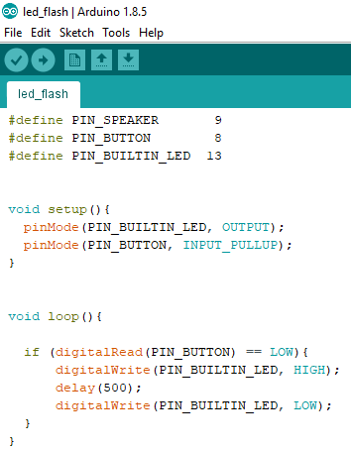
The led_flash sketch explained
This sketch is broadly organized into 3 sections
Definitions: which pins are used for what
This makes the code below easier to read
Setup() – function is run one time, each time the Arduino is powered up
Used to set pins as inputs or outputs
loop() – function is run over and over as long as the Arduino is powered up
Logic that determines what to do when button is pressed

Slide 15
INPUT_PULLUP explained
When Arduino pins are configured as inputs they can also be configured to have internal pull-up resistors enabled
These resistors provide a gentle pull-up to the Vcc of the device
When the switch is pressed, it pulls the pin to ground much more strongly than the pull-up pulls to Vcc.
Arduinos also have a pull-down option
5V
Logic
D8

Slide 16
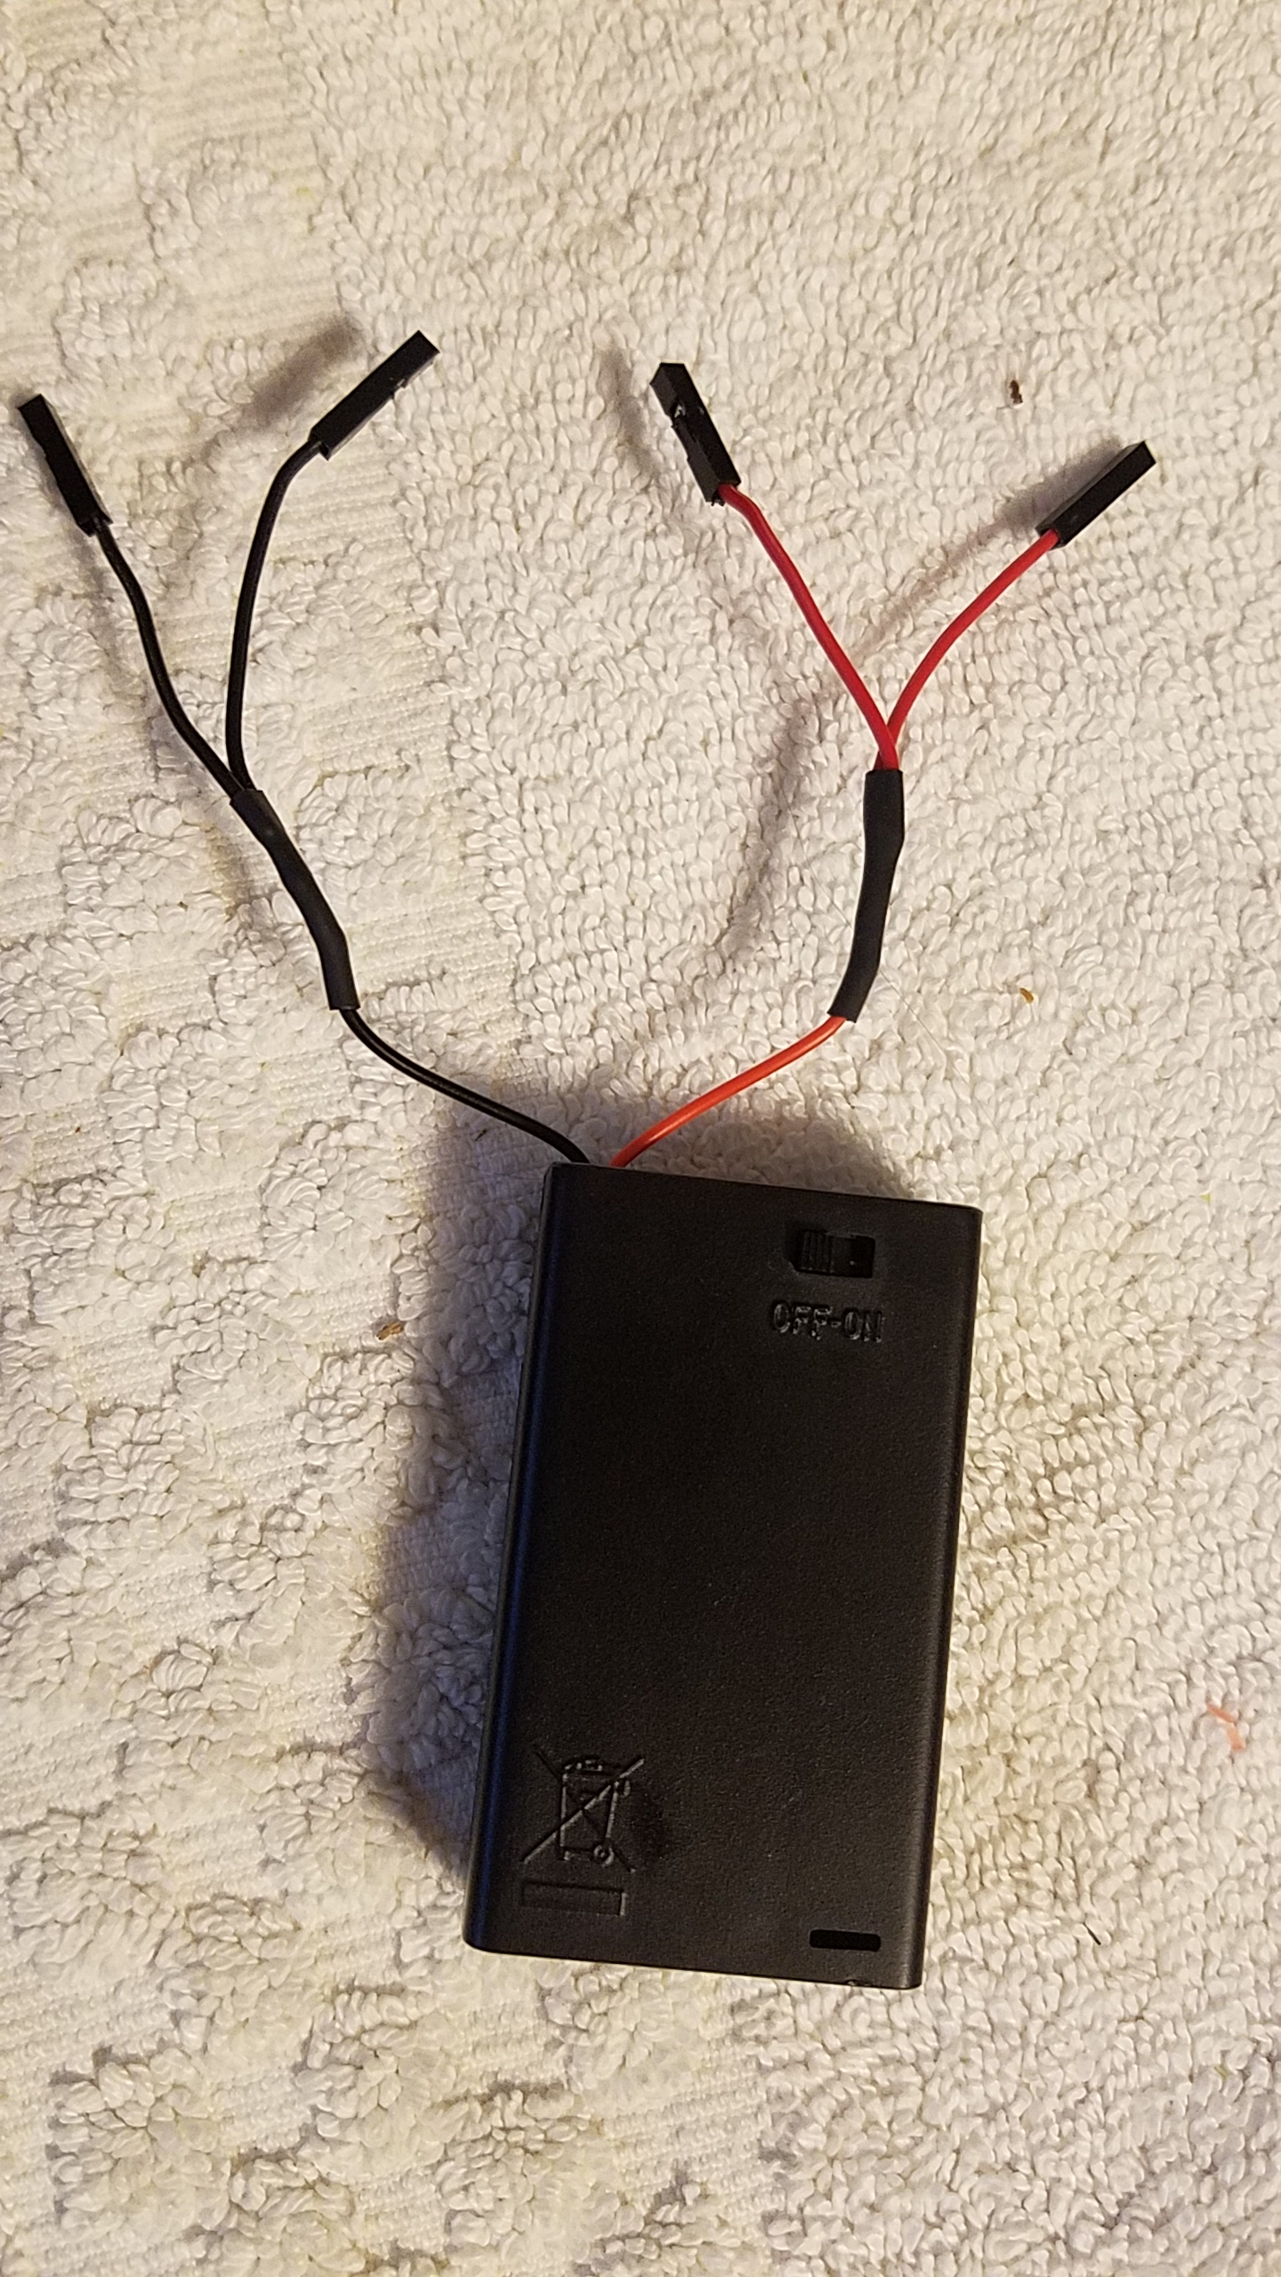
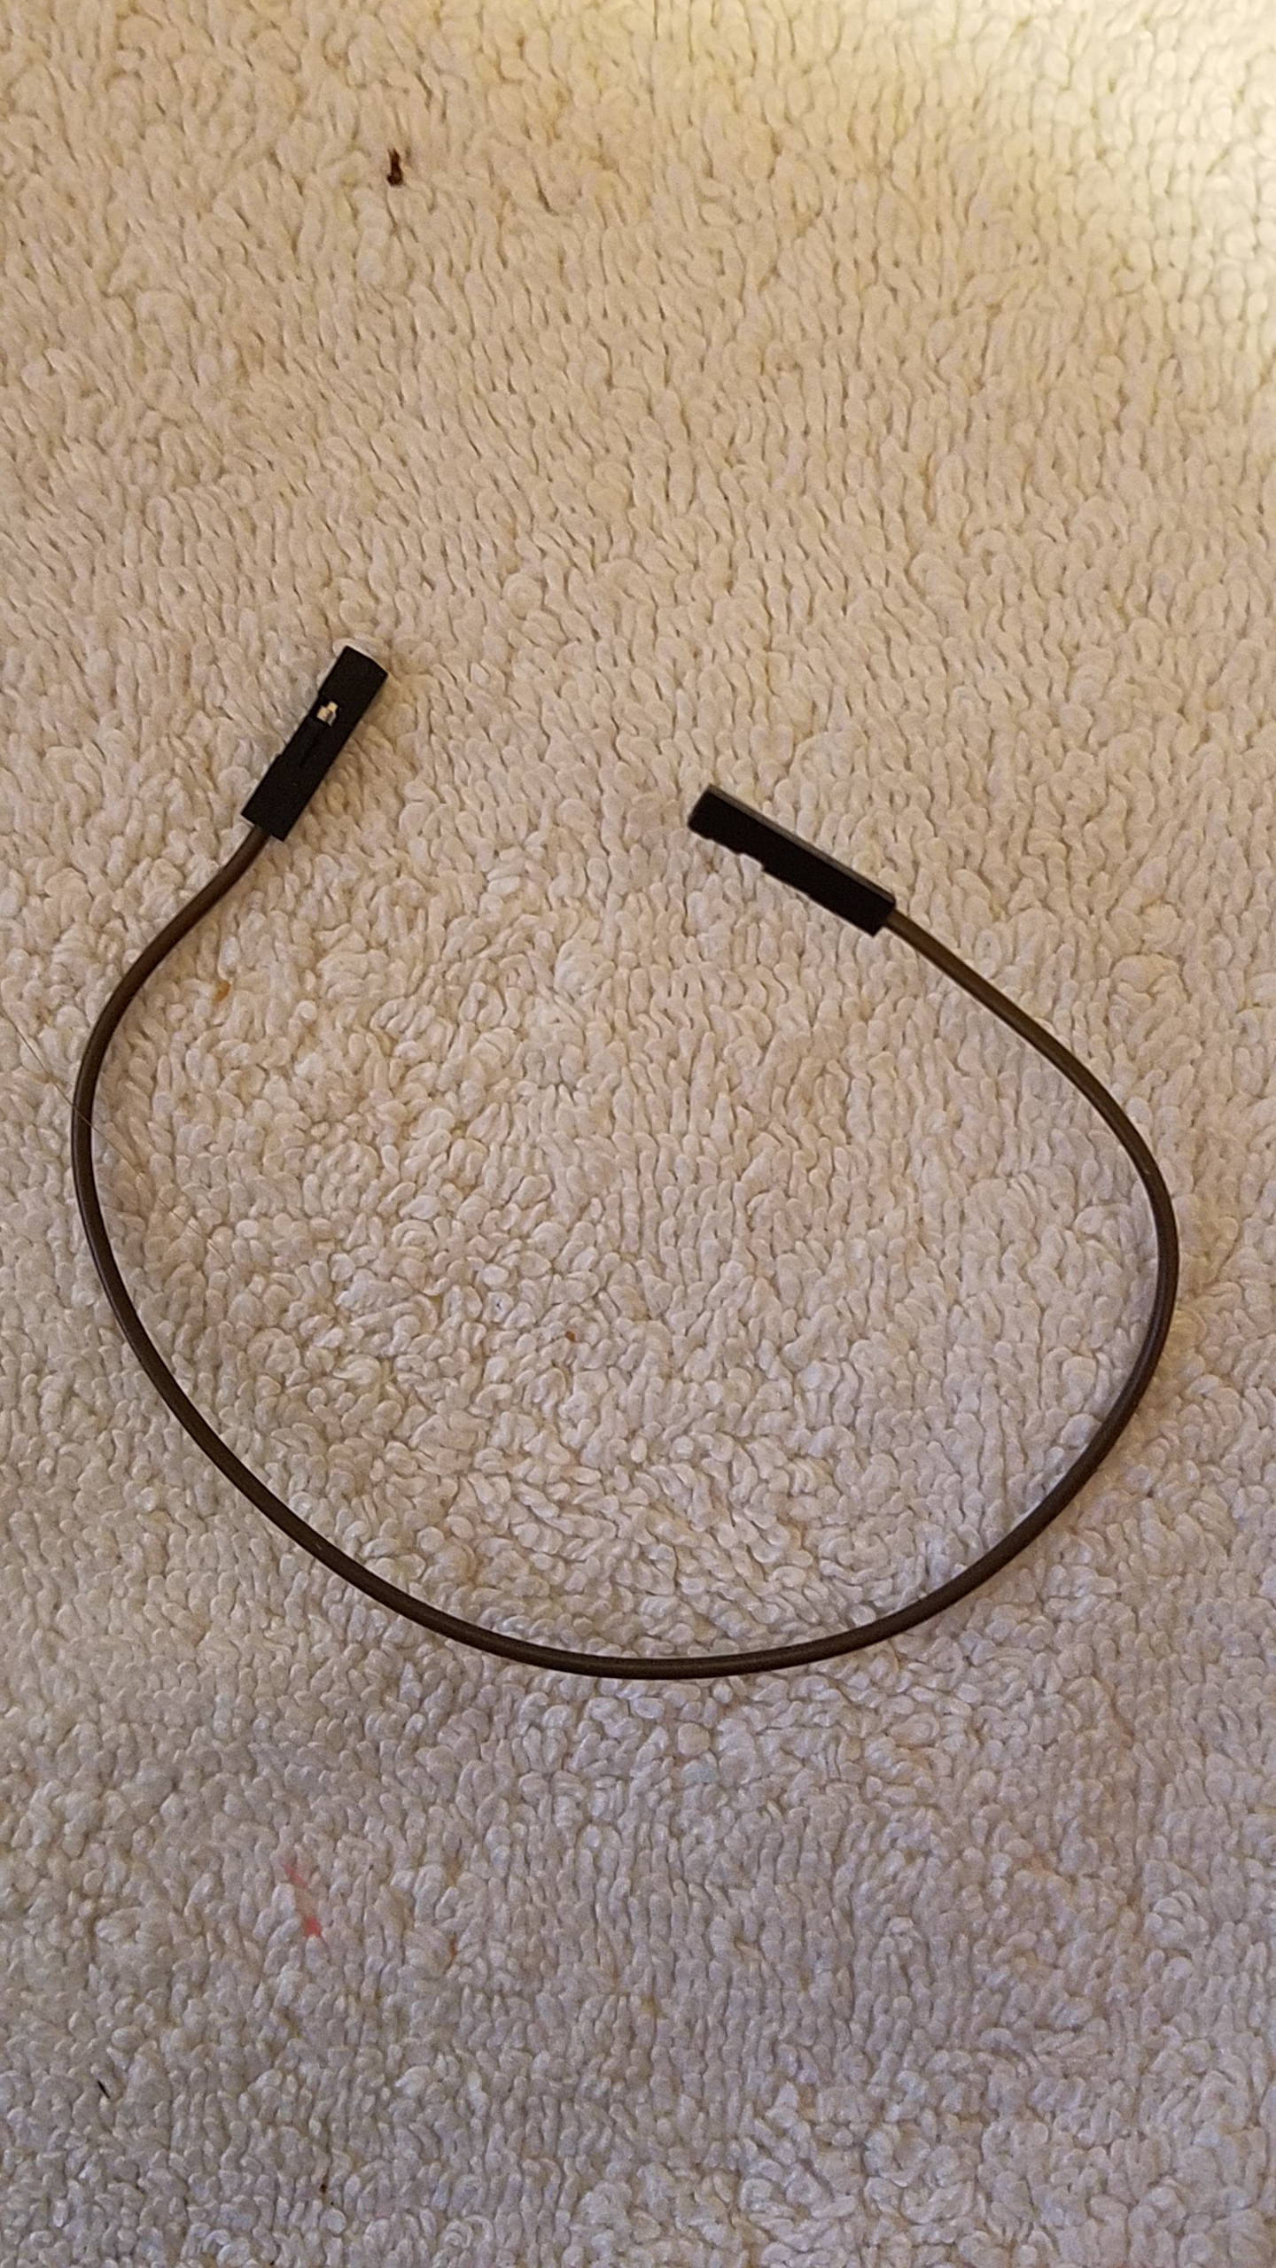
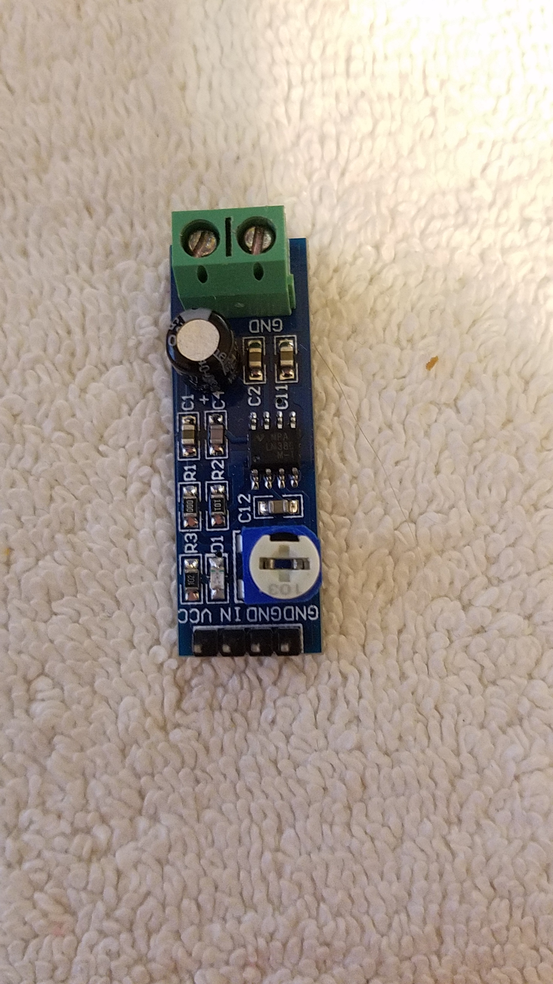
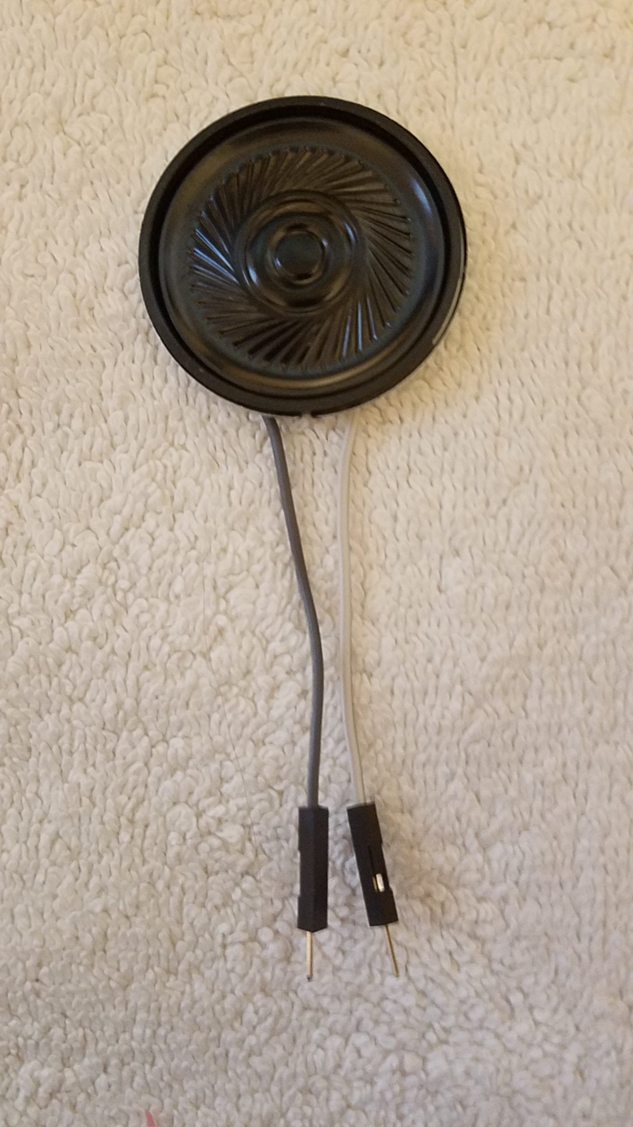
Let’s hook up the circuit so we have a speaker to use
Put AAA batteries in battery box
Turn battery box switch off
Connect battery box red leads to Arduino “5V” and Audio Amp “VCC”
Connect black leads to GND and GND
5. Connect the jumper wire from the Arduino D9 to the audio amp “IN”
6. Insert the speaker wire pins into the green terminals on the audio amplifier

Slide 17
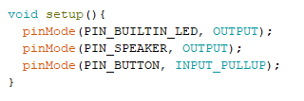
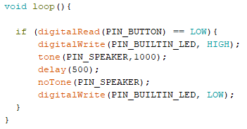
Now modify the code to make it play a tone when you press the button
Add this line to the setup()
Add these two lines to the code
Upload the sketch
Try it out!

Slide 18
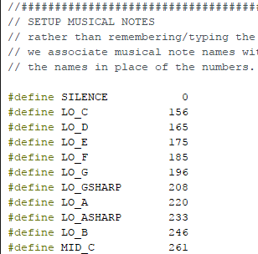
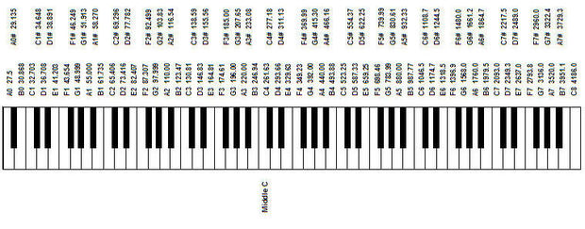
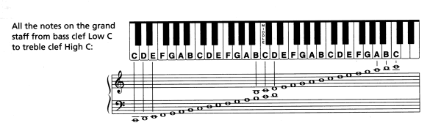
Now download fur_elise.ino, upload and try it out!
We added a few things to the definitions part of the sketch.
The first is a table that assigns names to frequencies, or notes.
In music, a key on the piano, or note on sheet music, corresponds to a particular frequency.

Slide 19
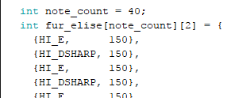
Now download fur_elise.ino, upload and try it out!
The melody is made up of 40 notes
We found with one version of the Arduino IDE we needed to replace “note_count” with “40” to avoid a compiler error
The melody is made up of pairs of note names and durations.
- Play the note HI_E for 150 milliseconds
- Then play the note HI_DSHARP for 150 milliseconds
- etc
The melody is stored in a data structure called a 2D matrix of int’s
int fur_elise[note_count] [2]
The matrix stores values that are of type “int” which means integers (-100, -4, 0, 2, 3940)
The name of the variable is “fur_elise”
The variable has 2 dimensions, rows and columns.
The number of rows is 40, the number of columns is 2

Slide 20
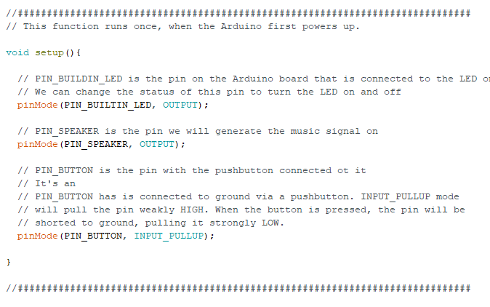
The Setup() portion is unchanged, just added comments

Slide 21
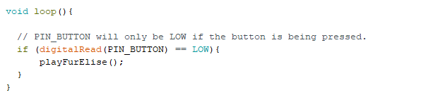
The loop() portion is slightly different
When the pushbutton is pressed, now we call the function playFurElise()
In software, a function is like a detour. When the Arduino gets to this point in the code it jumps to this function. When the function finishes, the Arduino continues from this point.

Slide 22
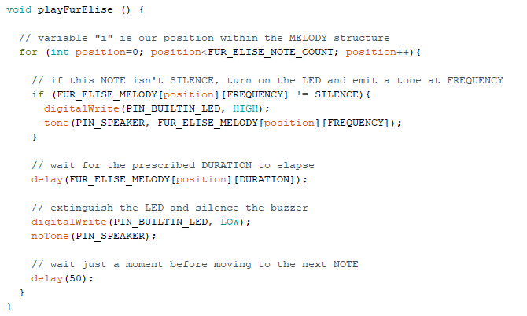
The playFurElise() portion is new, and a bit complicated
All this function does is go through the matrix of notes we looked at earlier, play them in sequence and blink the LED
Iterate through the matrix of notes
- matrices start at 0 (not 1)
Turn the LED on and off
tone() and noTone() play the notes
delay() lets the note play for the required duration

Slide 23
Finish it off
Put everything into the laser cut box
Hot glue the speaker behind the grill
Put the switch in the precut hole
Put a small bit of Velcro on the battery box and the laser cut box to affix it in place
Place everything else however you’d like
The solder connections to the speaker are a weak point so affixing the audio amp with a little Velcro would be a good idea
Optional
Download other sketches from the KM github
fur_elise.ino
Imperial_march.ino
3_melodies_in_1.ino
What next?
Have it play the melody twice
Require 2 button presses to play it one time
Write your own melody

